Slide 1

Healthcare Packaging
Sustainability
Kevin Mulligan
KMC Consulting
Sterile Medical Device
Packaging Specialist

Slide 2
Links
KMC Consulting
Covidien counts on machinery and materials in package development:
http://www.linkedin.com/pub/kevin-mulligan/13/307/111

Slide 3
Why is Sustainable Packaging Important?
Environmental impact will cause unprecedented change in the design and marketing of disposable medical devices
Hospital groups will make purchasing decisions based in part on sustainable packaging and product offerings
Significant cost benefit to manufacturers, distributors and hospitals
Regulatory compliance and environmental impact continue to expand

Slide 4
Why is Sustainable Packaging Critical to the success of Healthcare Manufacturers
“Significant changes in the handling and disposal of medical waste will occur over the next decade. They will be dramatic and unparalleled. Disposability will significantly impact the design criteria for medical devices and packaging, material management, practices in heath care institutions and to a certain degree, procedures performed by health care providers”
Companies that understand and embrace sustainability will have a significant competitive advantage in the marketplace. The organizations that best understand these opportunities, will develop strategies that will maximize profits, enhance revenue and enjoy leadership roles in driving good corporate citizenship.

Slide 5
What is Sustainable Packaging?¹
Meets market criteria for performance and cost; maintains product integrity
Maximizes the use of the 3 Rs; reduce, recycle, and reuse
Manufactured using clean production technologies defined in Life Cycle Analysis
Designed to optimize materials and energy consumption throughout the supply chain
Is effectively recovered and utilized in biological and/or industrial cradle to cradle cycles.

Slide 6
Medical Waste Stream in the U.S.
“ It is important to understand past and present methods of medical waste management, as well as the dominant forces that will drive significant change in the near future. U.S. hospitals produce 3.2 million tons of medical waste each year (vs. 220 billion tons in the U.S. municipal waste stream). Of that total, only 15% is technically classified as regulated medical waste capable of spreading infectious disease or inappropriate for the municipal waste stream. Packaging is a key focus and will be a big part of the solution in years to come.”
Industry can expect stricter legislation in years to come
Hospitals have shifted away from waste to energy strategy; disinfection of medical waste and landfill; reduction by weight is key focus by hospitals.
Debate of reusables vs. disposals will continue to be driving factor
Ability to develop recycling markets will be key

Slide 7
Voice of the Customer (VOC)
Goal:
Identify value added environmental packaging opportunities that benefit our customers.
▪ Solicit feedback
▪ Understanding their supply chain, unique usage requirements, recycling & waste
▪ Aligning our efforts & policies

Slide 8
Voice of the Customer (VOC)
Feedback:
▪ Increase source reduction efforts
▪ Increase use of recycled materials
▪ Eliminate PVC and DEHP
▪ Continue to innovate by using new packaging materials and configurations
▪ Utilize sustainability scorecards
▪ Investigate recycling opportunities
▪ Collaborate with distributors and kit packagers

Slide 9
Packaging Modeling
A robust package modeling application for engineers to use was essential.
The tool allows the user to input detailed packaging information that is used to perform a series of objective calculations.
This can be a useful and easy way to demonstrate the environmental impact of making a packaging change.

Slide 10
Packaging Waste Spider Diagram
Provides an objective environmental assessment
Software is used as an industry standard in retail markets
Accepted by key Health Care providers: Kaiser Permanent, Inova, Yale Medical
Hospitals can objectively see benefit and comparison

Slide 11
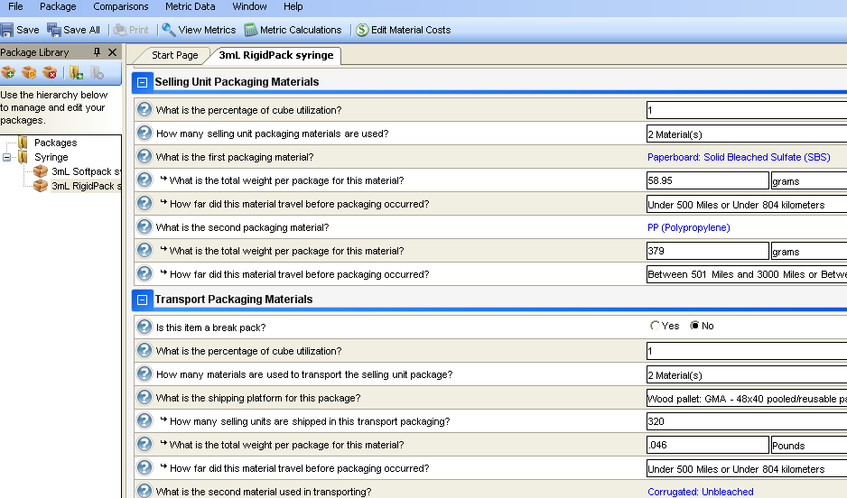
Package Modeling Software: Data Entry
Packaging attributes are entered here

Slide 12
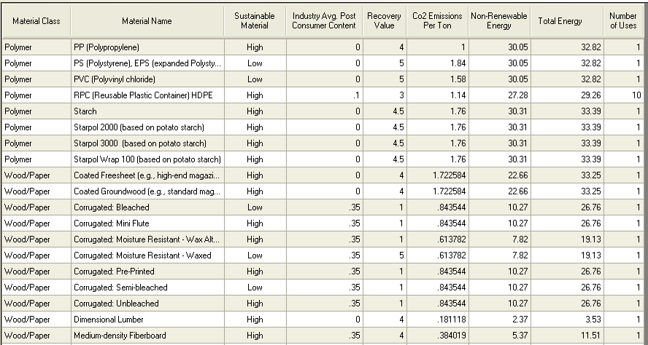
Package Modeling Software: Materials Data
attributes and numerical standards are assigned to each packaging material
Common packaging materials are available to choose from

Slide 13
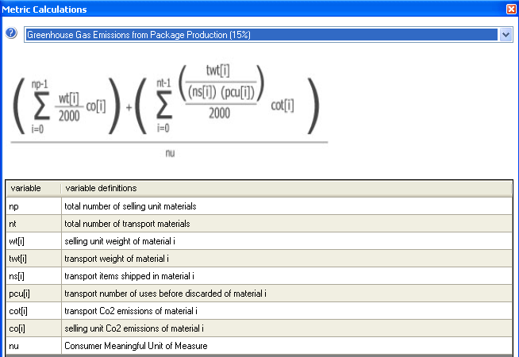
Package Modeling Software: Calculations
The packaging material standards are used to perform a series of calculations

Slide 14
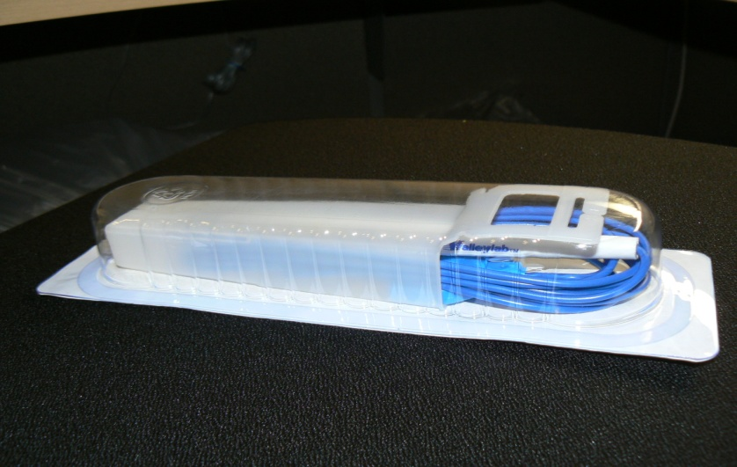
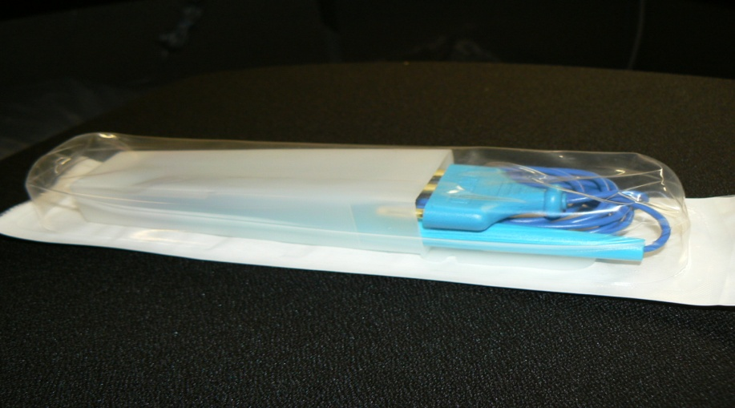
Sustainable Package change
CURRENT DESIGN: PROPOSED DESIGN:
Rigid PETG tray Flexible nylon film
Coated Tyvek Uncoated paper
Paper insert Eliminate paper insert
Printed IFU CD and web page replace IFU

Slide 15
Benefits with Sustainable Package change
Eliminated over 75,000 pounds of packaging material
69 fewer truck loads per year; 30% more product per ETO cycle
Reduced ETO cycle by 50% with uncoated paper
Savings over $600K per year
Compliance with ISO 11607 standard

Slide 16
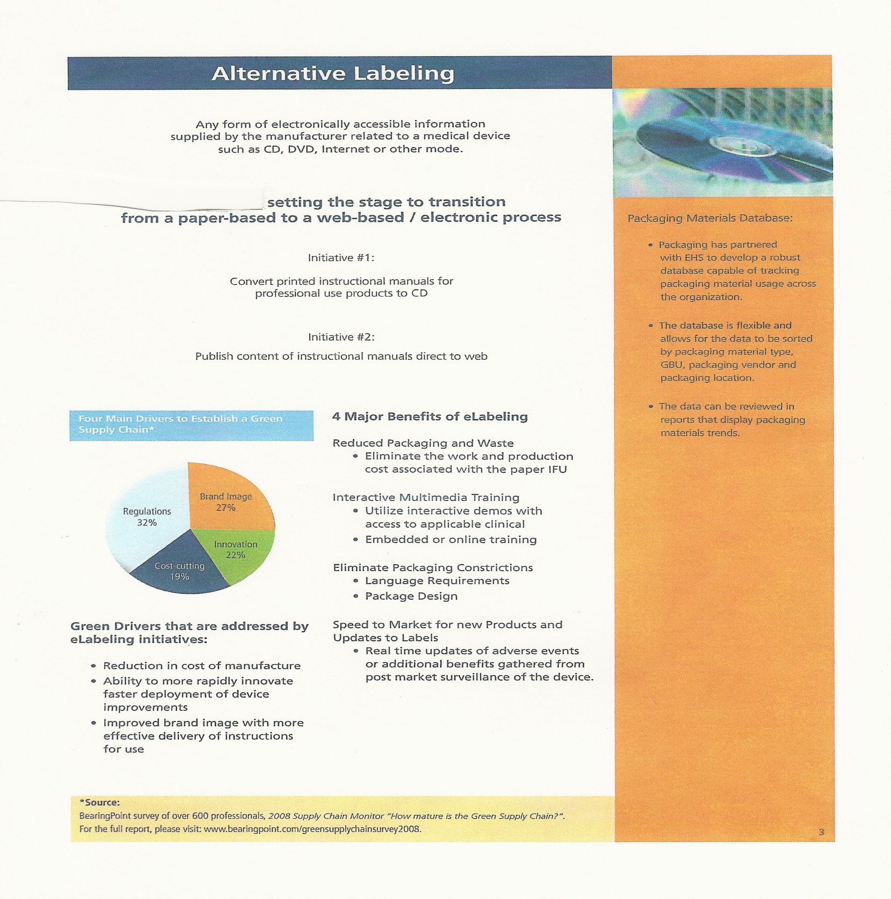

Slide 17
Package Modeling:
Comparison of Environmental Indicators
**smaller numbers (data points closer to the center) are preferred.

Slide 18
Packaging Waste Calculator
Customized environmental waste calculator provides instant feedback on the benefit of switching to a new product.
This can be a useful and easy way to demonstrate packaging waste disposal cost savings.
Hospitals can objectively see benefit to bottom line

Slide 19
Package Materials:
Disposal Impact
Switching to softpack is a 50% improvement

Slide 20
Packaging Sustainability in Healthcare
Sustainability is key to purchasing decision in hospitals
Objective assessment models afford opportunity for companies to differentiate products in market place
Companies can achieve significant cost reduction, meet and or exceed compliance requirements
Companies have the opportunity to lead in corporate citizenship with good business models in support of environmental impact

